Slide 1
Project Two: Machine Learning
Crypto Investment Analysis & Recommendation
Team:
Anthony Segovia
Josina Baiao
Fabrice Salomon
Chad Burford
Clifford Charles

Slide 2
Project One: Crypto Price Prediction & Technical Analysis
Project Goals:
Use Machine Learning Models to predict future prices, volatility and sentiment of a Crypto Currency – Ripple (XRP)
Code Indicators to perform Technical Analysis for entry/exit recommendations
Automate results using a Bot (AWS Lex) and automated script (AWS Lambda & Sagemaker)
Machine Learning Models:
ARIMA & GARCH
LSTM - Long Short Term Memory
AutoTS – Time Series
NLP Sentiment Analysis
Technical Analysis Indicators:
Fibonacci Retracement
Simple Moving Average - 30 & 200
Bollinger Bands
MACD

Slide 3
Code Approach: Analysis
Price Prediction – Time Series & Sentiment
Pull in data from Yahoo Finance – use Date, Open, High, Low, Close, Adj Close, and Volume
Create Dataframe required for particular model
Scale data if required
Create Train and Test data split if required
Estimate the Model
Fit the Model
Output Summary Results / Evaluate the Model
Technical Analysis Indicators

Slide 4
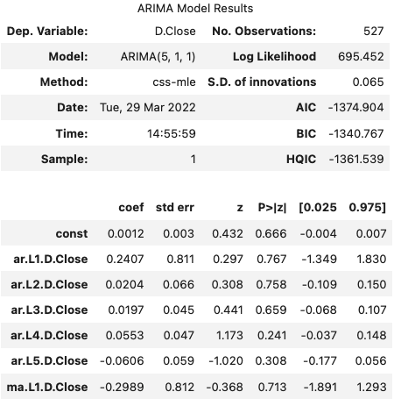
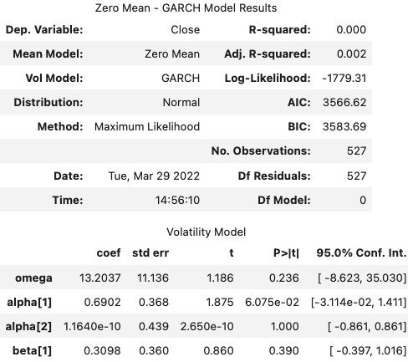
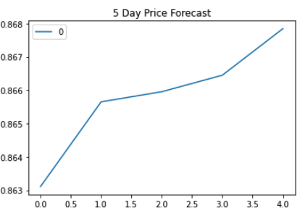
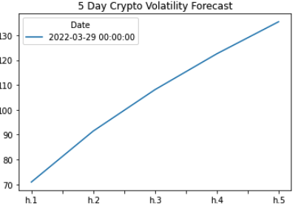
Crypto Price Prediction & Volatility – ARIMA & GARCH

Slide 5
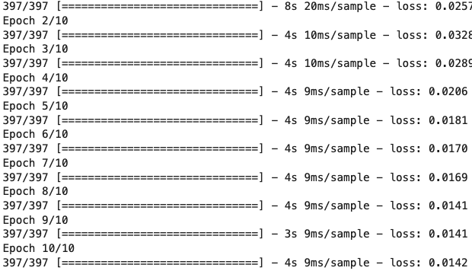
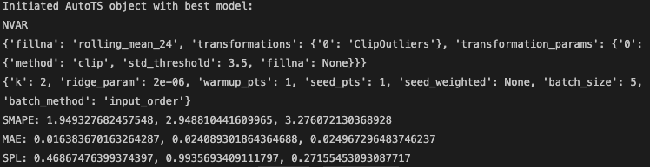
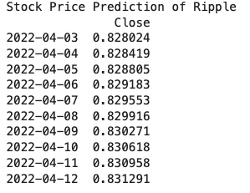
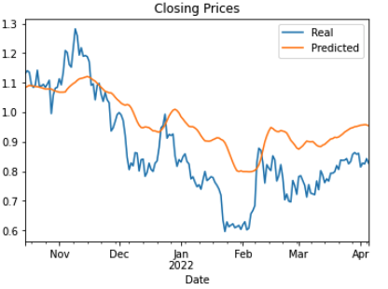
Crypto Price Prediction – LSTM & AutoTS ML Models
LSTM
AutoTS
Test loss – 0.006283935380162876

Slide 6
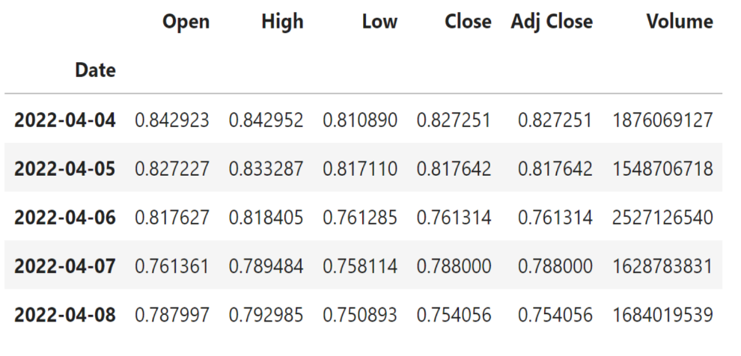
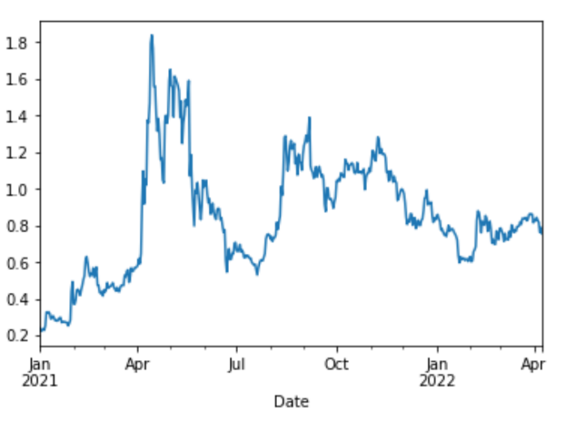
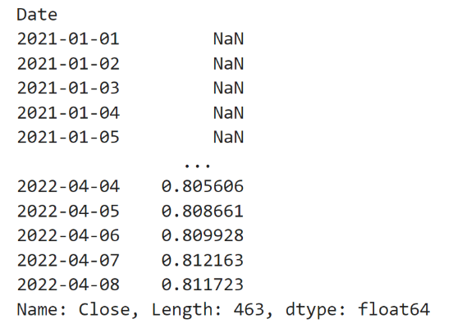
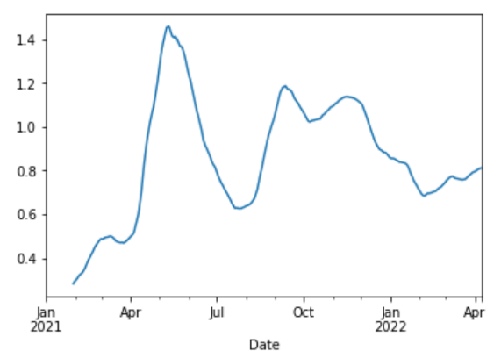
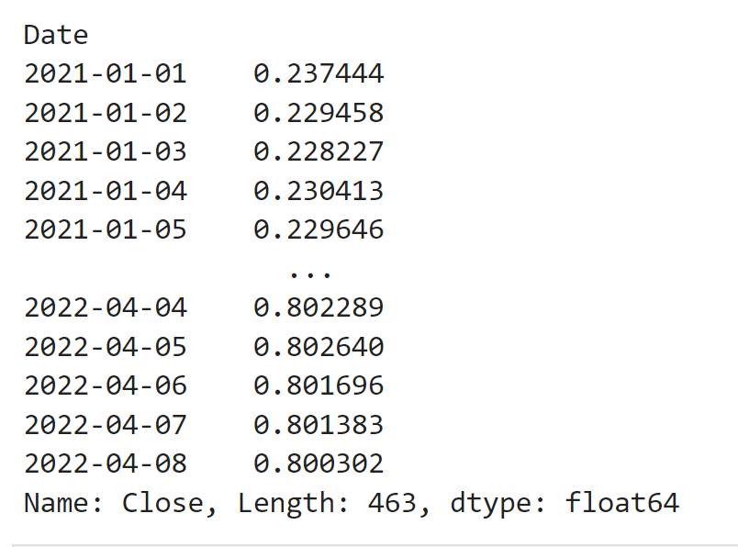
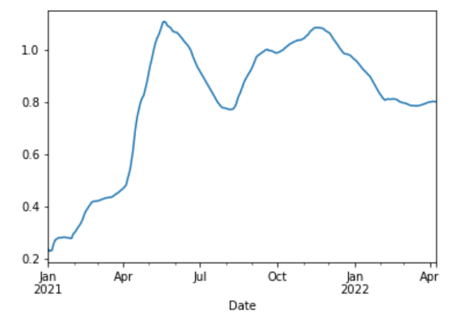
Crypto Price Technical Analysis – 30 & 200-Day SMA & EWMA
Simple Moving Average / 30-day look back period
Exponentially-Weighted Moving Average / 30-day look back period

Slide 7
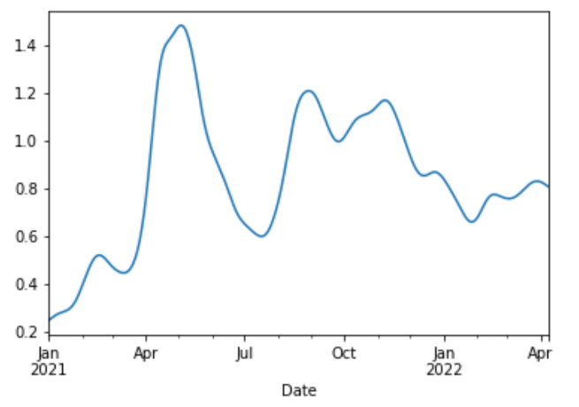
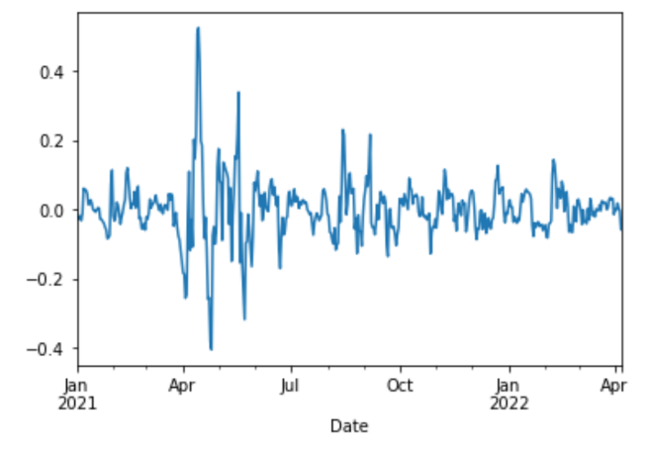
Crypto Price Technical Analysis – 30 & 200-Day SMA & EWMA
Simple Moving Average / 200-day look back period
Exponentially-Weighted Moving Average / 200-day look back period
Hodrick-Prescott Filter
Trend Noise

Slide 8
Bollinger Bands
Bollinger Bands are a TA indicator are plotted at a standard deviation level above and below a simple moving average of the price

Slide 9
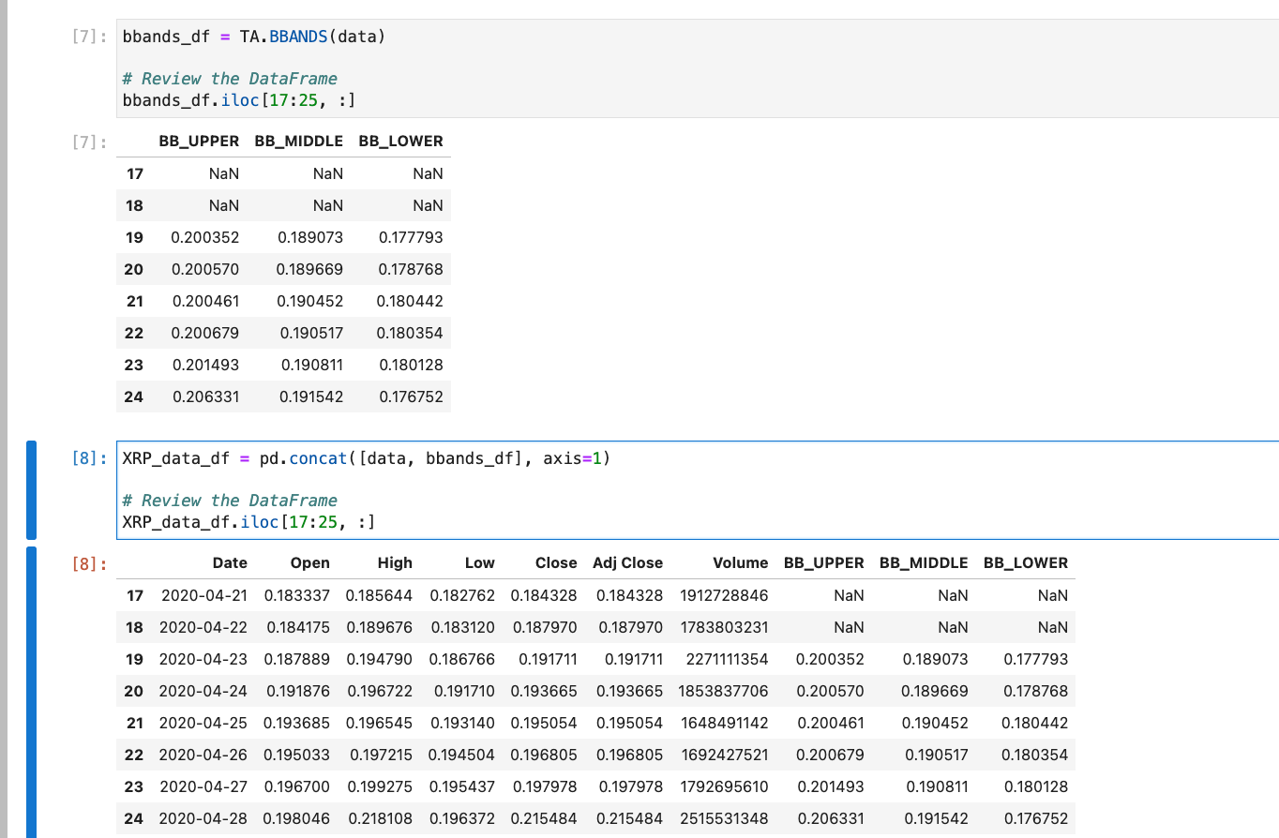
XRP Bollinger Bands

Slide 10
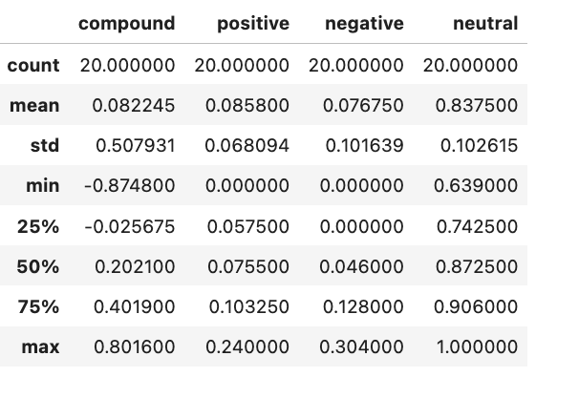
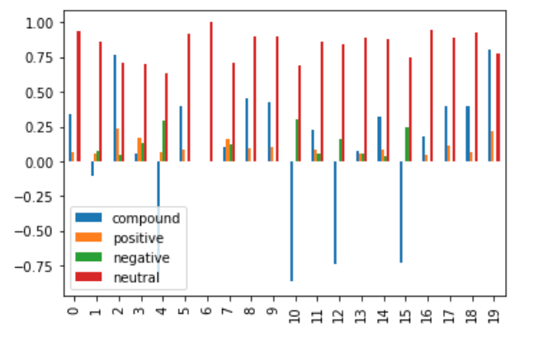
XRP Sentiment Analysis

Slide 11
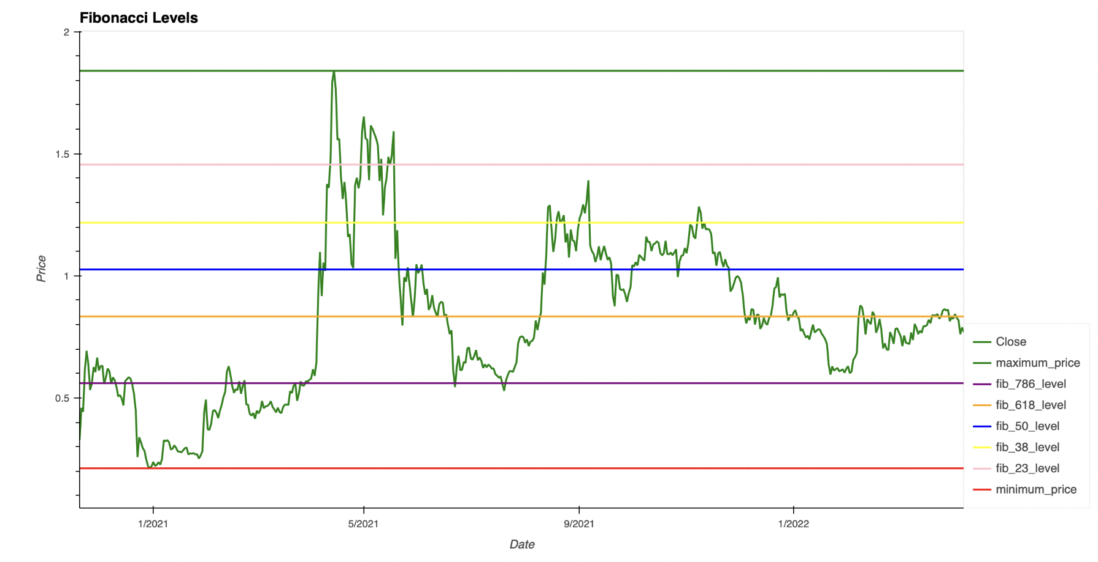
Fibonacci Retracement Levels
A Fibonacci retracement is created by taking the highest and lowest points in a stock chart and dividing the distance by the key Fibonacci ratios of 23.6%, 38.2%, 50%, 61.8%, and 100%.Scale data if required

Slide 12
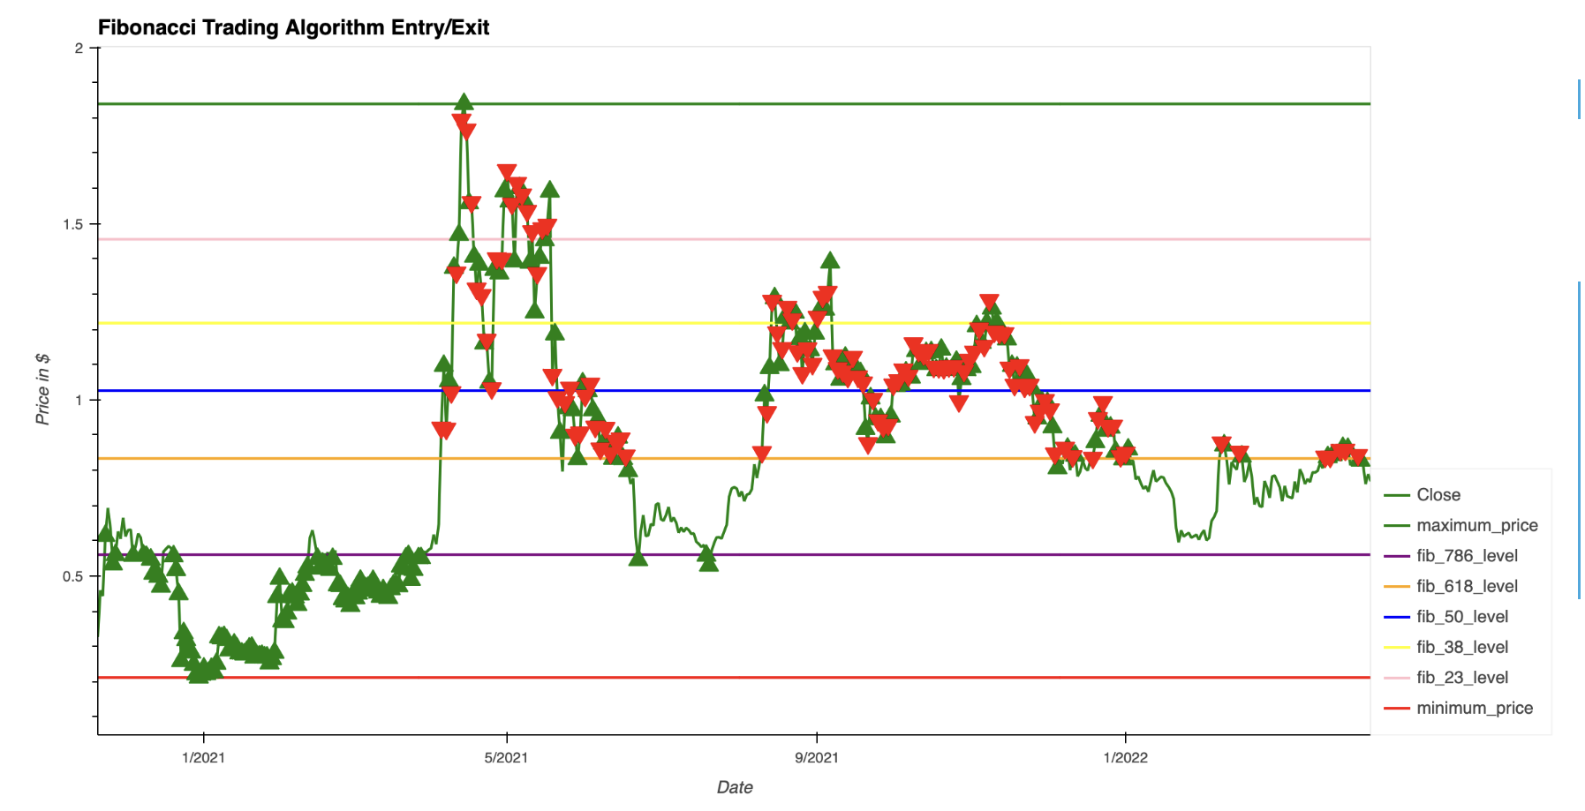
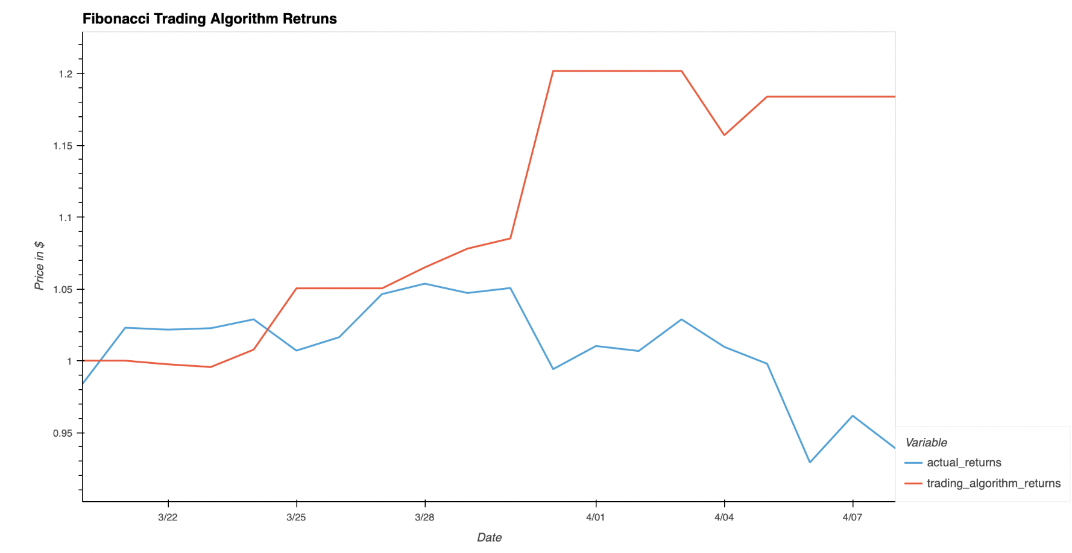
Fibonacci Retracement Entry / Exit

Slide 13
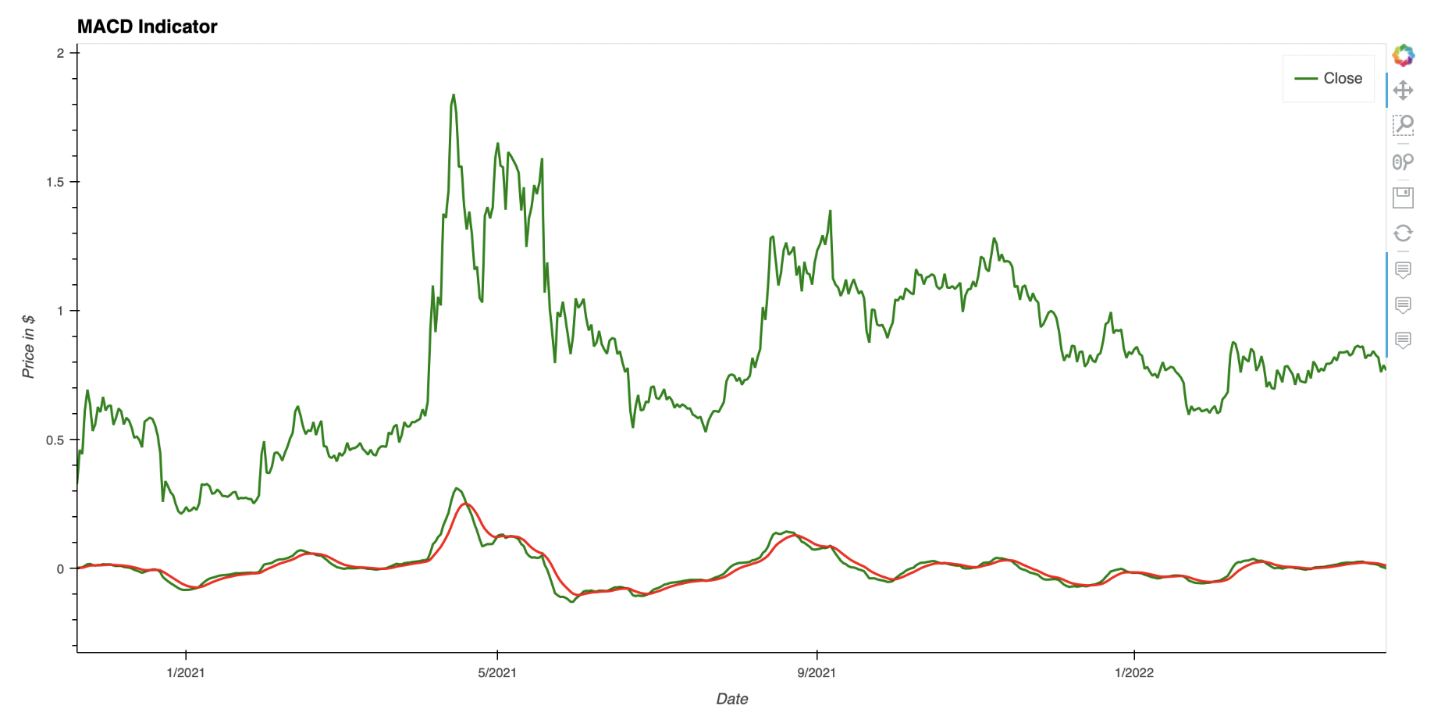
Moving Average Convergence Divergence(MACD)
Moving average convergence divergence (MACD) is a momentum indicator that shows the relationship between two moving averages of a stock or crypto price.
The MACD is calculated by subtracting the 26 day EMA from the 12 day EMA
A nine-day EMA ‘Signal line’ is then plotted on top of the MACD line. When the ‘Signal line’ crosses the MACD line this can function as a trigger for buy or sell.
Caption

Slide 14
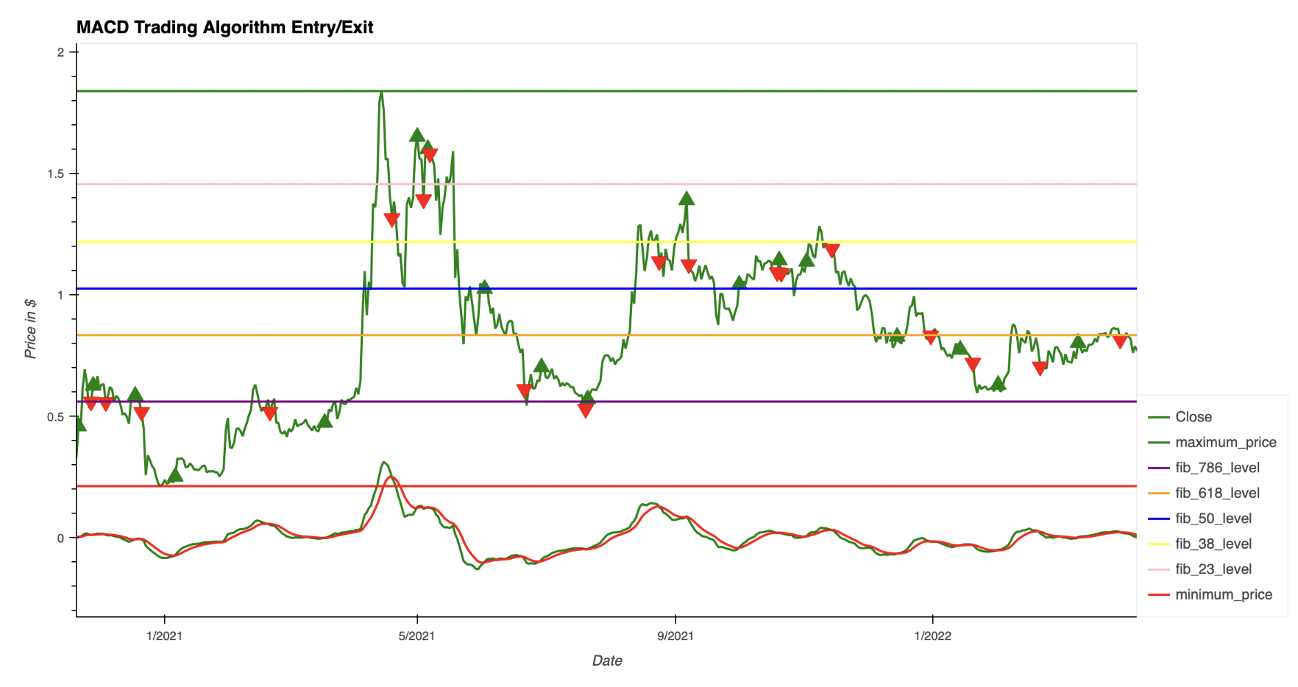
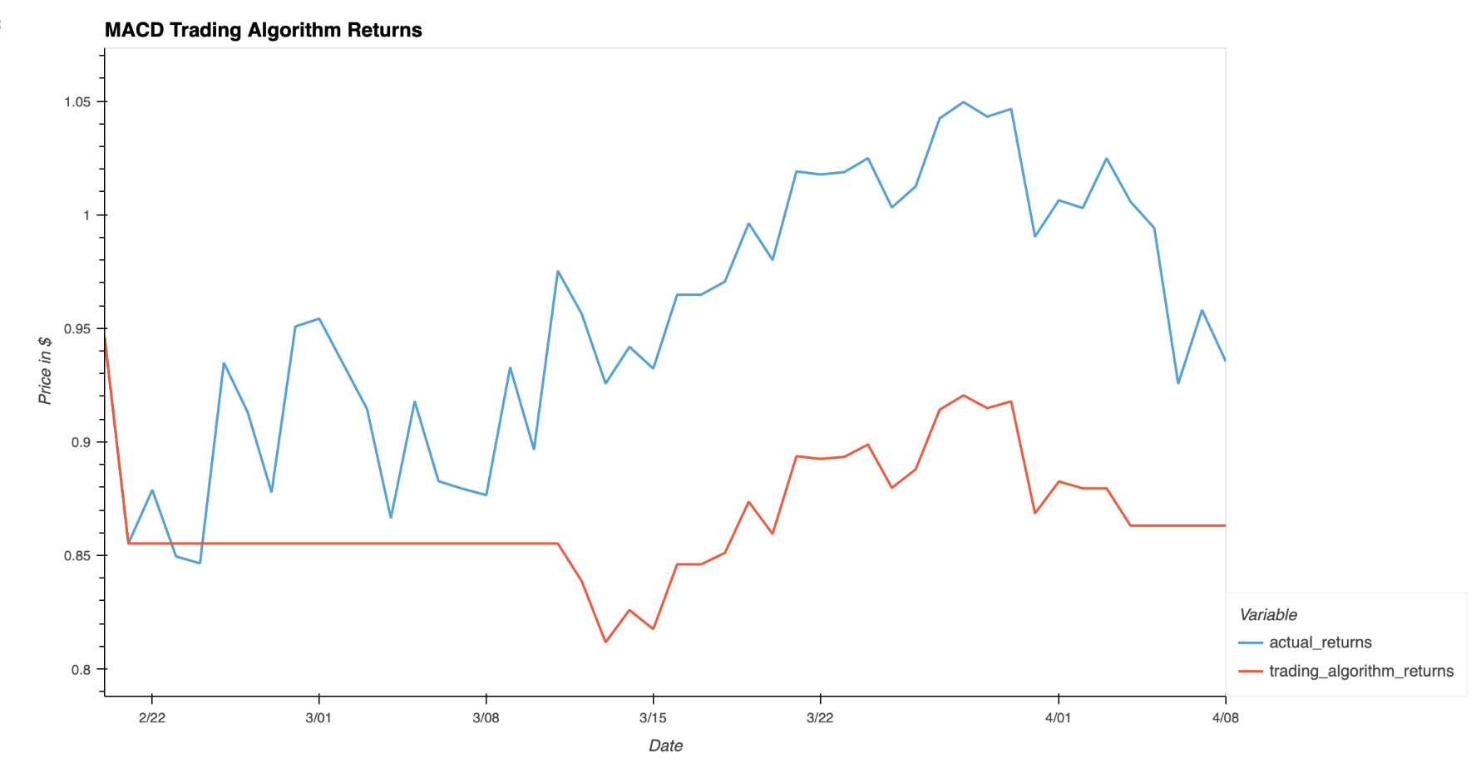
Code Approach: Analysis

Slide 15
Summary - Investment Recommendations
(for academic use only, NOT for specific investment advice)
Price Prediction
All three models showed upward price predictions over the upcoming week
The GARCH volatility model showed higher risk, but this is not uncommon in the crypto space
The Sentiment Analysis showed relatively neutral, which is a positive signal, as crypto stocks have been in a down-turn since November of 2021
Technical Analysis
Analysis of the Moving Average indicators, we see an upward trend in XRP with the lower MA crossing up and over the higher MA around March 17th
We also see the price action moving up past the Fibonacci 0.382 band and towards the 0.5 band, showing a bullish signal
Lastly, the Bollinger Band analysis shows an upward trend but not breaking out above the high band. The band is trending slightly upward, but looks to be consolidating, which could be an indicator of a break-up in price.
Our XRP investment recommendation, based on price prediction models and technical analysis, is a buy at this time

